Slide 1
Sensor Networks for monitoring, disaster rescue operations

Slide 2
3D mobile ad-hoc networks
Aerial networks
Use of UAVs (drones)
Platforms –
NS3 + ROS
CPP + Python
https://www.ros.org/about-ros/
https://www.nsnam.org/documentation/
Underwater networks
Use of AUV (Gliders, miniature vehicles, submarines etc.)
Platforms –
Unetsim (Java based)
https://unetstack.net/

Slide 3
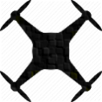
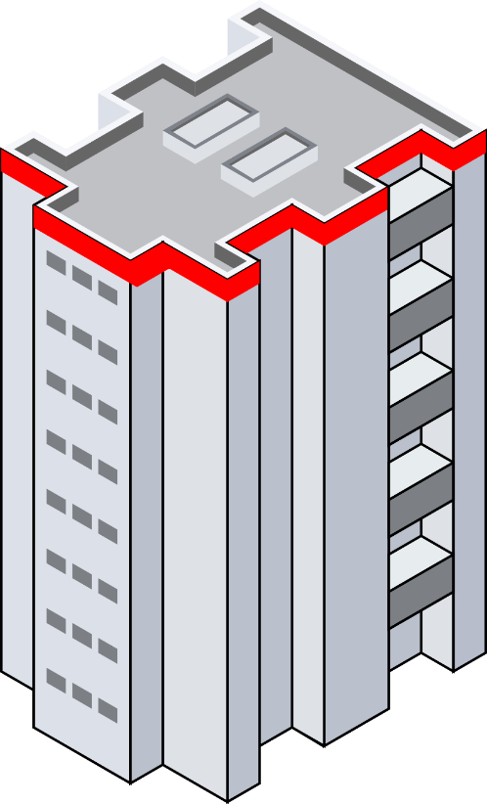



uav_message
My_ID | 9
My_Pos | 9_Position
Dst_ID | 100 (Unicast)
Nbr_table | (8,100)
Type of MSG | Generic
Control | 0 0000 0000
State | 10 0010
P_ID | -
P_ID_Pos | -
4
6
2
1
8
7
9
5
3

Slide 4

2
1
ROS
Feed New position to Drone
Step - 4
ROS
Get Position and time from GPS of Drone
Step - 1
ROS – NS3 communication link
NS3
Receive message and Extract data fields including new position
Step - 3
NS3
Convert position and time data along with ID, direction and Rc into message and Transmit
Step - 2

Slide 5
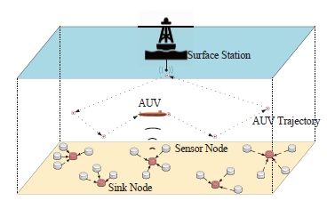
Underwater network

Slide 6
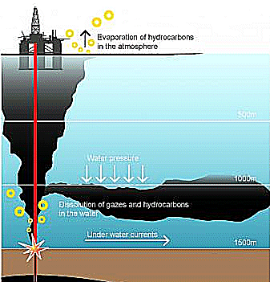
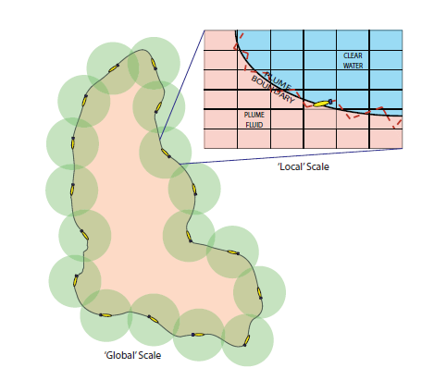
Ocean phenomenon/Plume monitoring

Slide 7
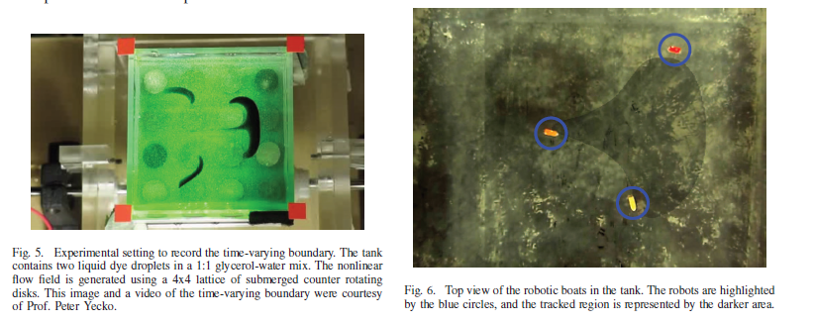

Slide 8
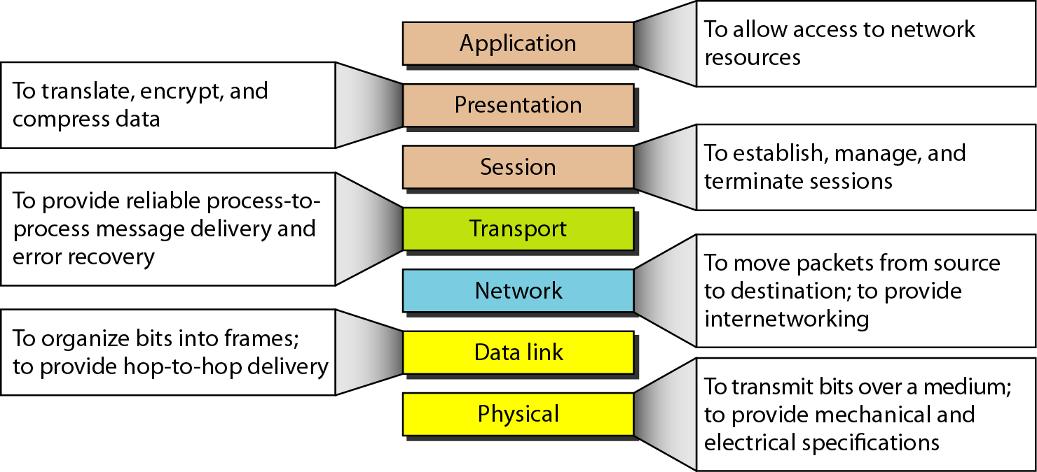
Computer network – OSI model summary

Slide 9
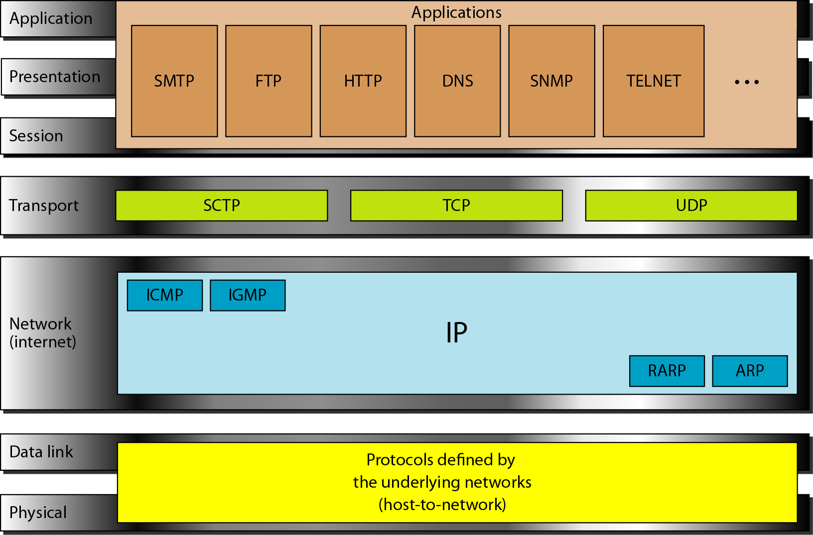
TCP/IP and OSI comparison

